Slide 1
Major Stages of Entrepreneurship
Converging on the idea
Business Plan and Business Models (Mobilizing Resources)
Business Formation (Operations and Management)
Growth/ exit
Going public

Slide 2
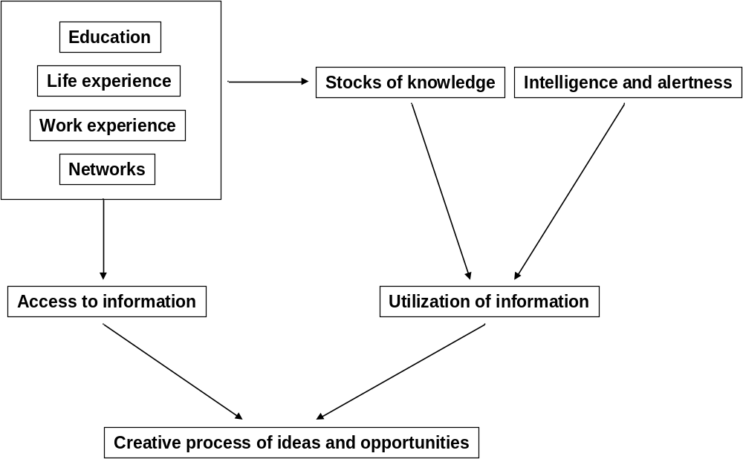
The Idea Machine

Slide 3
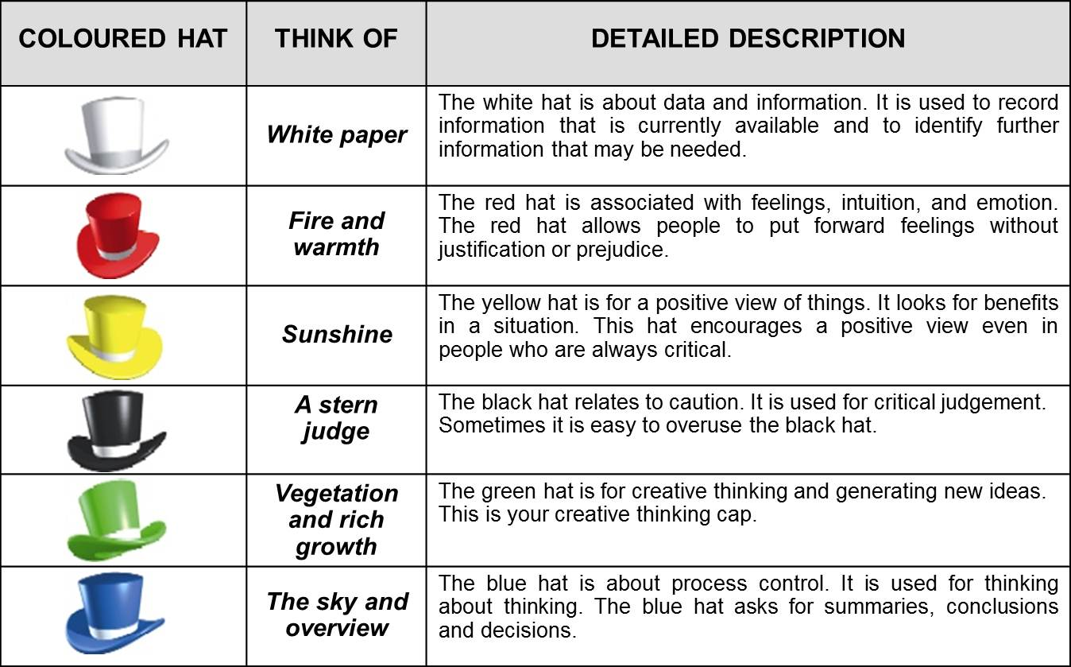
DE BONO’S SIX THINKING HATS

Slide 4
Growth of a Business Idea
Pre-selection process
Sources of Business Ideas
Preliminary Research
Evaluation of Business Idea

Slide 5
Pre-Selection Process
Discovering your personal traits
How much do you enjoy meeting other people?
Your ability to work in an unstructured environment.
Ability to organize and structure
Leadership qualities you possess
Appetite for risk
Deep analytical skills
Energy Level
Multitasking

Slide 6
Knowledge and Experience
You bring into your enterprise not only your personality and skills but also your knowledge and experience. Experience contributes to and sharpens one’s knowledge.
Technical Knowledge
You acquire technical knowledge during formal training or education. What we learn in theory gets validated and enhanced by actual experience in execution.
Domain Knowledge
Refers to knowledge very specific to certain industry in which you intend to work.

Slide 7
Contacts
You tend to build up a lot of professional contacts during your work life, like old colleagues, clients and vendors. The width of contacts refers to how many people you know. The depth refers to the strength of the relationship. The quality refers to the ability to positively impact your business.
Goals and Aspirations
Think about your short-term and long term goals. For a business to be sustainable , both the goals have to connect well.

Slide 8
SOURCES OF BUSINESS IDEAS
Past work experience
Hobbies and Interests
Travel
Distribution Channels
Strengths and Abilities
Business Idea
Brainstorming
Research Organizations
Current Trends
Friends and Family
The Web

Slide 9
Sources of New Ideas
Consumers
  Informally monitor potential ideas and needs.
  Formally arrange for consumers to express their opinions.
Existing Products and Services
  Analysis uncovers ways to improve offerings that may result in a new product or service.
Distribution Channels
  Channel members can help suggest and market new products.

Slide 10
Sources of New Ideas (cont.)
Federal Government
  Files of the Patent Office can suggest new product possibilities.
  New product ideas can come in response to government regulations.
Research and Development
  A formal endeavor connected with one’s current employment.
  An informal lab in a basement or garage.

Slide 11
Methods of Generating New Ideas
Focus Groups
  A moderator leads a group of 8 to 14 participants through an open, in-depth discussion in a directive or nondirective manner.
  An excellent method for generating and screening ideas and concepts.

Slide 12
Methods of Generating New Ideas
Brainstorming
  Allows people to be stimulated to greater creativity.
  Good ideas emerge when the brainstorming effort focuses on a specific product or market area.
  Rules of brainstorming:
    No criticism.
    Freewheeling is encouraged.
    Quantity of ideas is desired.
    Combinations and improvements of ideas are encouraged.

Slide 13
Methods of Generating New Ideas (cont.)
Brainwriting
  A form of written brainstorming.
  Participants write their ideas on special forms or cards that circulate within the group.
Problem Inventory Analysis
  Consumers are provided with a list of problems and are asked to identify products that have those problems.
  Results must be carefully evaluated as they may not actually reflect a new business opportunity.

Slide 14
PRELIMINARY RESEARCH
Cost Structure
Market Structure
Research Areas
HR issues
Technology
Government Regulations

Slide 15
Preliminary Research
Cost Structure
Main costs involved?
Market Structure:
Trends of the selling market?
Dominant players?
Strong industry association?
Technology: Changes in technology

Slide 16
Preliminary Research (contd.)
HR Issues
Is the work hazardous?
Do you provide adequate safety measures?
Are you prepared to deal with trouble in-case something goes wrong?
Government Regulations
Entry barriers?
Long time to get government clearance?
Costly?

Slide 17
EVALUATION OF IDEAS
Major Five Questions
Q1. Which is the Product/ Service?
Clearly state and describe the product or service that you are providing with benefits
Identify the important problem of the customer.
Think about the value you can offer.
Focus on the ‘need’ of the customer rather than selling the attributes of your product/ services.
Is the customer willing to pay more for solving his problem.

Slide 18
Q2. What is the Business Model?
A business model is a description of various aspects of business.
Detailed product description
Overview of how it is going to be produced and delivered.
Can the business develop and employ superior organizational processes, capabilities or resources compared to its competitors?
Does the business seem profitable?

Slide 19
Q3. How big is your market?
Idea about how much to invest.
How many total customers are there? (Size of the market)
How many will buy from you? (Share in the market)
How many such customers can be convinced to switch to your product.

Slide 20
Q4. How can you protect your business?
Some strength that gives you advantage over others?
Critical Success Factors?
People in the industry?
Q5. What are you getting out of it?
Profits?
Payback?
Business you are looking forward to.

Slide 21
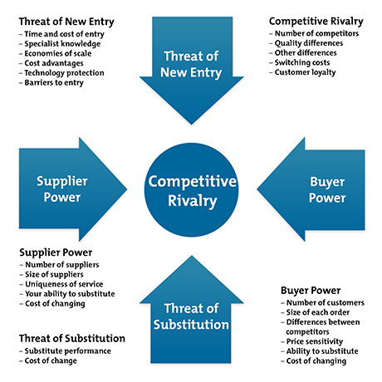
PORTER’S FIVE FORCES

Slide 22
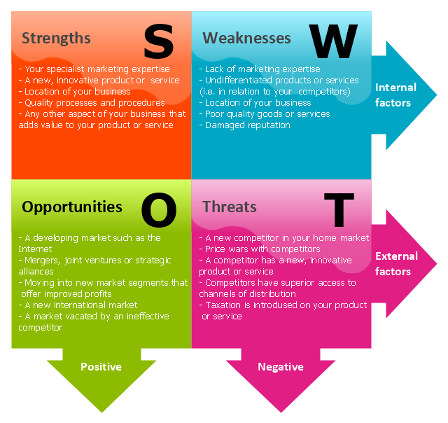
SWOT Analysis

Slide 23
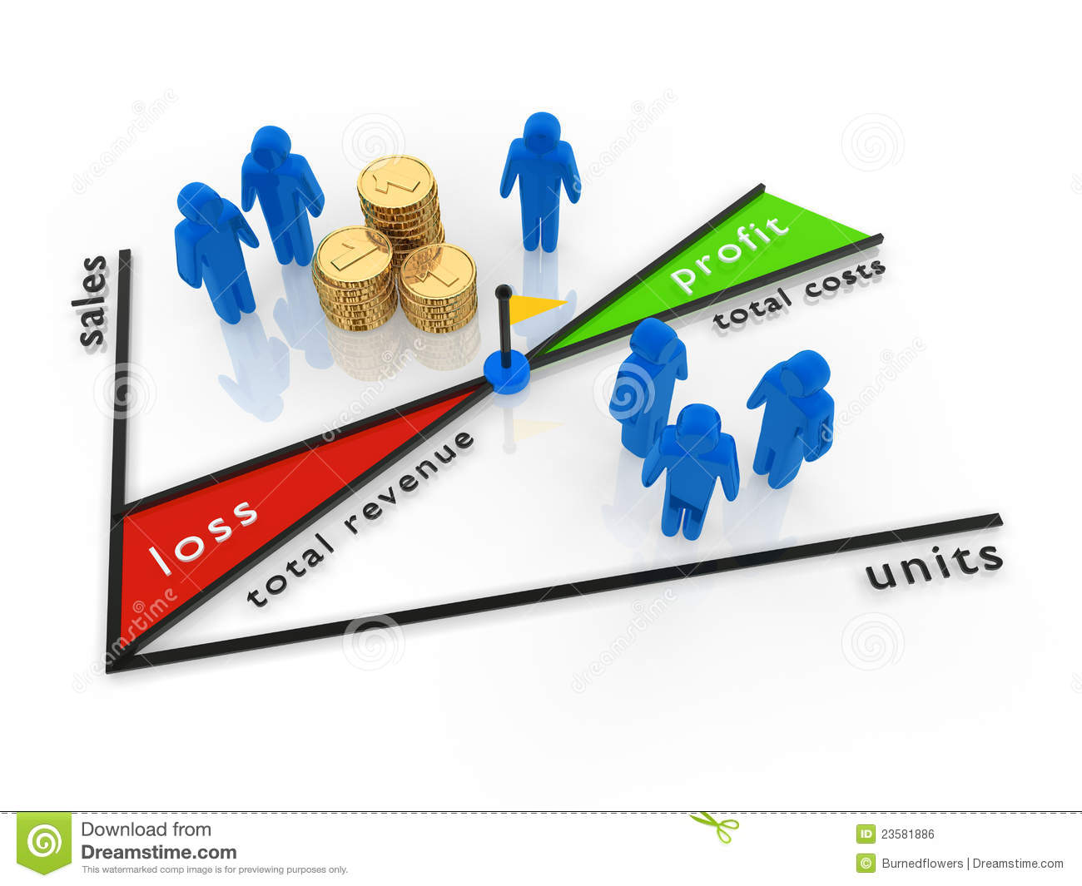
BREAK EVEN ANALYSIS

Slide 24
Thank You

